Slide 1
DATA SCINCE CAPSTONE PROJECT
BATTLE OF NEIGHBORHOODS
Amit Sarkar
IBM DATA SCIENCE PROFESSIONAL CERTIFICATE

Slide 2
INTRODUCTION
I live in a city called Kolkata. It's one of metropolitan city in India. French author Dominique Lapierre called this City of Joy, It can be considered as food capital of India.
So recently one of my friend Reshmi Mazumdar wished to open a Chinese restaurant in Kolkata. But she is not sure about the location where she should open her restaurant.
So she discussed with me about her dream project as she was aware about my learning Data science in Coursera.

Slide 3
INTRODUCTION Contd.
So I thought below business problem for her:
She should open her restaurant in a location where there are enough customers and minimum competitor restaurant.
We should explore all the qualified venues in Kolkata to decide best location for Chinese restaurant.
Need to know what category of customers are available whether they are target customers by their age.
Based on all the information we need to maximize score and decide the best location.

Slide 4
DATA
To help Reshmi Mazumdar for her dream project we need below data:
All area names of Kolkata which we have researched and make a csv file.
Based on area name we have accessed longitude and latitude data by using geolocator.
Based on area name, longitude and latitude data we have accessed nearby venues by foursquare API.
For each location we got N numbers of venues with different categories i.e. Chinese restaurant, cinema, station etc.

Slide 5
Libraries used for the project
Pandas – A data manipulation and analysis library
Numpy - Scientific computing with Python
Geopy - To locate the coordinates of addresses, cities, countries, and landmarks across the globe
Folium – Map creation library

Slide 6
Chinese restaurant
Below criteria have been chosen to decide best location to open a Chinese restaurant in Kolkata.
There should be minimum direct competitor in that location i.e. there shouldn’t be so many Chinese restaurants.
It’s better to have some shopping places around the chosen location.
It’s a plus to have some movie theater around the location.
The location to be chosen where commute station is present i.e. bus station, railway station etc. as bus and railway are major public transportation mode in Kolkata.

Slide 7
Implementation
We have collected area data from different source and make a csv file which has been kept in GitHub repository.
we have used GeoPy library to access longitude and latitude data for each location in the csv file and saved in another csv file.
Using above location data we have created neighborhood map of Kolkata.
We have accessed venues data by using FourSquare API
We have given negative weightage if Chinese restaurant is available around the venue as this this the direct competitor of the business.

Slide 8
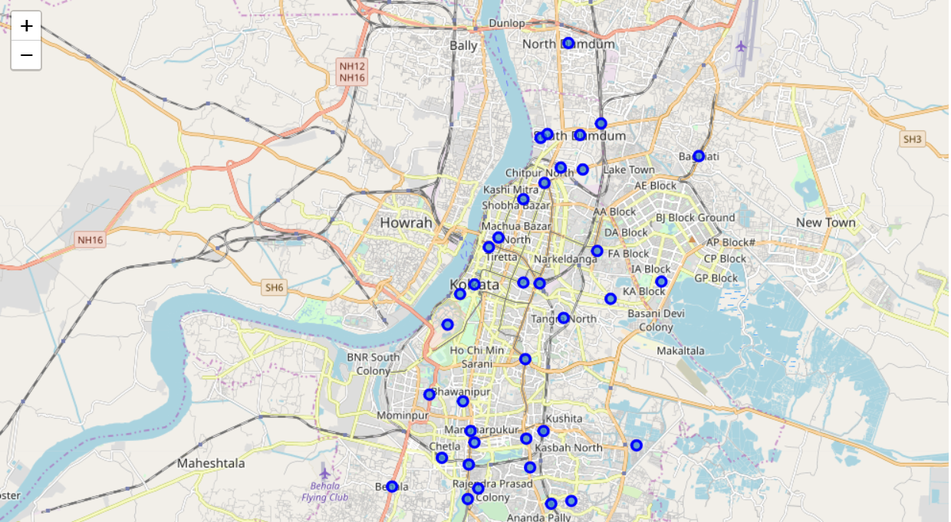
Kolkata neighborhood map

Slide 9
Score calculation
Total score = -0.5 * Chinese restaurant + Station + Cinema + Park + Shopping mall
Based on total score formula we have chosen location with maximum total score.

Slide 10
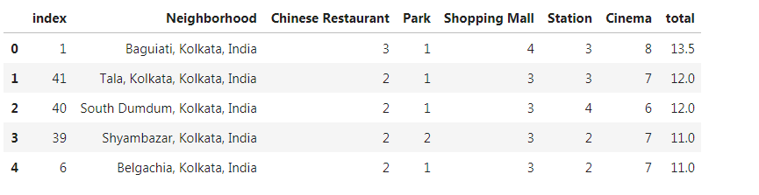
Result

Slide 11
Conclusion
Below is best location to open Chinese restaurant in Kolkata
Baguiati, Kolkata, India

